Slide 1
INTRODUCTION TO COMPUTING
Course Code: CCINCOM/L
Monte-Carlo Method
Elizer Ponio Jr.
Faculty Member
Department of Computer Science
College of Computing and Information Technologies (CCIT)
National University
Joseph Marvin R. Imperial
REINFORCEMENT LEARNING
NU College of Computing and Information Technologies
Course Code: CCRNFLRL

Slide 2
Outline
INTRODUCTION TO COMPUTING
Course Code: CCINCOM/L
Introduction
Monte-Carlo Method
Monte-Carlo Prediction
Monte Carlo Control
First Visit vs Every Visit
Joseph Marvin R. Imperial
REINFORCEMENT LEARNING
NU College of Computing and Information Technologies
Course Code: CCRNFLRL

Slide 3
Model-Free Reinforcement Learning
INTRODUCTION TO COMPUTING
Course Code: CCINCOM/L
Previous lecture:
Planning by dynamic programming
Solve a known MDP
This lecture:
Model-free prediction
Estimate the value function of an unknown MDP
Joseph Marvin R. Imperial
REINFORCEMENT LEARNING
NU College of Computing and Information Technologies
Course Code: CCRNFLRL

Slide 4
Outline
INTRODUCTION TO COMPUTING
Course Code: CCINCOM/L
Introduction
Monte-Carlo Method
Monte-Carlo Prediction
Monte Carlo Control
First Visit vs Every Visit
Joseph Marvin R. Imperial
REINFORCEMENT LEARNING
NU College of Computing and Information Technologies
Course Code: CCRNFLRL

Slide 5
Monte-Carlo (MC) method
INTRODUCTION TO COMPUTING
Course Code: CCINCOM/L
MC is an example of model free learning that only requires past experience to learn.
MC is model-free: no knowledge of MDP transitions/rewards
It does this by calculating the average reward of taking a specific action A while in a specific state S over many games.
Joseph Marvin R. Imperial
REINFORCEMENT LEARNING
NU College of Computing and Information Technologies
Course Code: CCRNFLRL

Slide 6

Monte-Carlo (MC) method
INTRODUCTION TO COMPUTING
Course Code: CCINCOM/L
The term “Monte Carlo” is usually used to describe any estimation approach relying on random sampling.
In MC, we do not assume knowledge of our environment, but instead only learn from experience, through sample sequences of states, actions, and rewards obtained from interactions with the environment.
Joseph Marvin R. Imperial
REINFORCEMENT LEARNING
NU College of Computing and Information Technologies
Course Code: CCRNFLRL

Slide 7
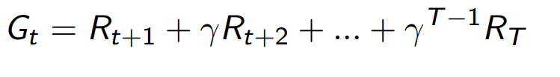


Monte-Carlo Policy Evaluation
INTRODUCTION TO COMPUTING
Course Code: CCINCOM/L
Our Goal: Learn $the value function{ v}_{\text{π}} from episodes of experience under policy$π
Recall that return is the total discount reward:
Recall that the value function is the expected return from any state s
γ stands for the discount factor, t stands for timestep, R stands for reward, V stands for value and S stands for state.
Joseph Marvin R. Imperial
REINFORCEMENT LEARNING
NU College of Computing and Information Technologies
Course Code: CCRNFLRL

Slide 8
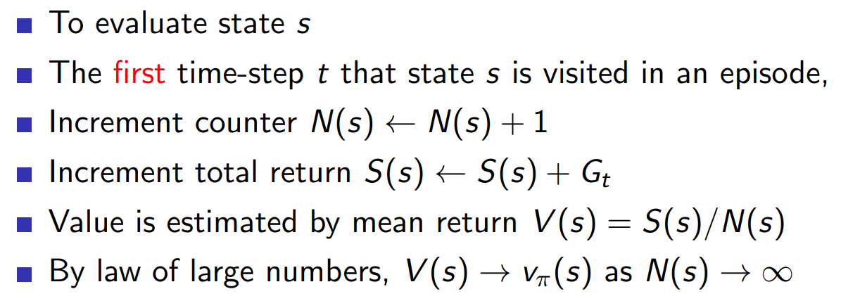
First-Visit Monte-Carlo Policy Evaluation
INTRODUCTION TO COMPUTING
Course Code: CCINCOM/L
π stands for policy, t stands for timestep, R stands for reward, V stands for value and S stands for state.
Joseph Marvin R. Imperial
REINFORCEMENT LEARNING
NU College of Computing and Information Technologies
Course Code: CCRNFLRL

Slide 9
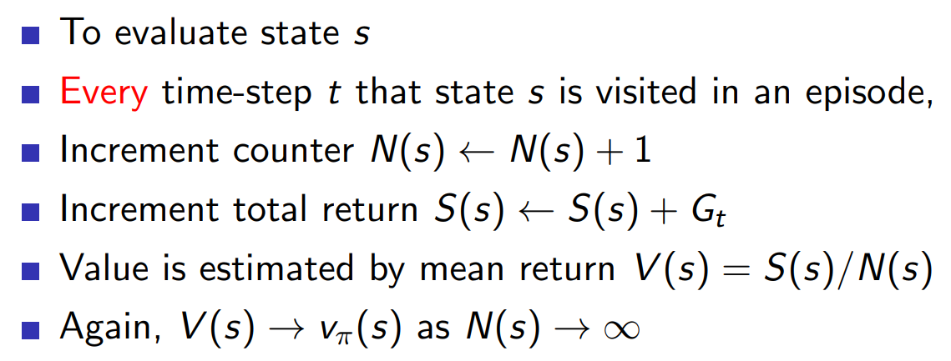
Every-Visit Monte-Carlo Policy Evaluation
INTRODUCTION TO COMPUTING
Course Code: CCINCOM/L
π stands for policy, t stands for timestep, R stands for reward, V stands for value and S stands for state.
Joseph Marvin R. Imperial
REINFORCEMENT LEARNING
NU College of Computing and Information Technologies
Course Code: CCRNFLRL

Slide 10
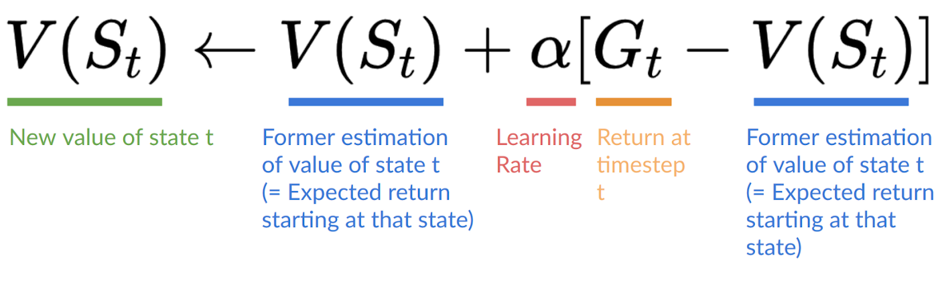
Incremental Monte-Carlo Update
INTRODUCTION TO COMPUTING
Course Code: CCINCOM/L
Joseph Marvin R. Imperial
REINFORCEMENT LEARNING
NU College of Computing and Information Technologies
Course Code: CCRNFLRL

Slide 11
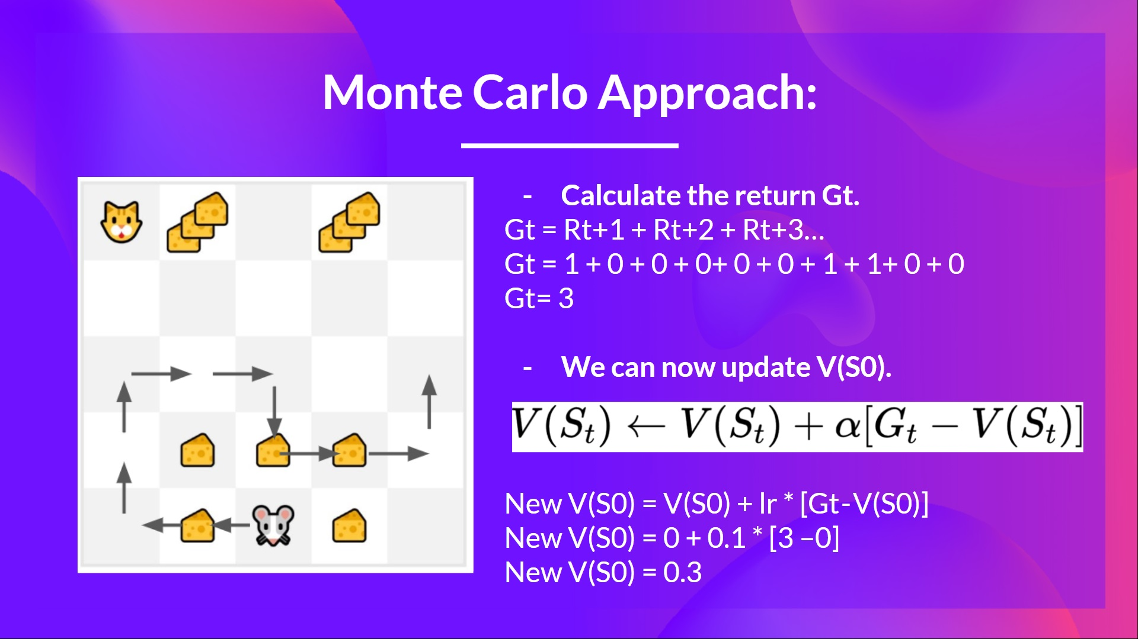
Incremental Monte-Carlo Update
INTRODUCTION TO COMPUTING
Course Code: CCINCOM/L
Joseph Marvin R. Imperial
REINFORCEMENT LEARNING
NU College of Computing and Information Technologies
Course Code: CCRNFLRL

Slide 12
Summary
INTRODUCTION TO COMPUTING
Course Code: CCINCOM/L
Sample-based learning methods allow us to estimate state and state-action values without any knowledge of transition dynamics, simply through sampling.
Monte-Carlo approaches rely on random sampling of a model, observing the rewards returned by the model, and collecting information during normal operation to define the average value of its states.
Generalized Policy Iteration is possible through Monte Carlo methods.
The value of all possible combinations of player and dealer hands in Blackjack can be judged through repeated Monte Carlo simulations, opening the way for optimized strategies.
Joseph Marvin R. Imperial
REINFORCEMENT LEARNING
NU College of Computing and Information Technologies
Course Code: CCRNFLRL

Slide 13
References
INTRODUCTION TO COMPUTING
Course Code: CCINCOM/L
Images are licensed with Creative Commons. Can use without citing.
Prof. Emma Brunskill’s slides (CS234RL). https://web.stanford.edu/class/cs234/slides/lecture1.pdf
David Silver’s slides. https://www.davidsilver.uk/wp-content/uploads/2020/03/intro_RL.pdf
Review in Probability, Intro to RL Concepts
Joseph Marvin R. Imperial
REINFORCEMENT LEARNING
NU College of Computing and Information Technologies
Course Code: CCRNFLRL

